Slide 1
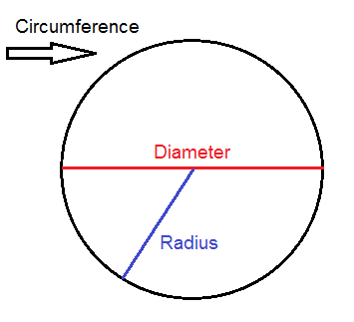
Hands On!
Circumference, Diameter,
Radius,
Oh My!
Danielle Camporese

Slide 2
Goals:
The student will understand how to calculate the circumference of a circle using different objects.
The student will understand that Pi is the ratio of a circle’s circumference to its diameter.

Slide 3
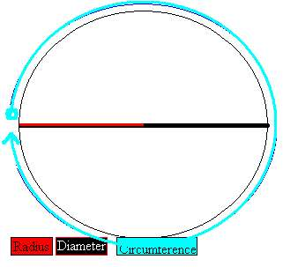
Objective:
Given three different objects, the student will calculate the circumference of each object with 100% accuracy.

Slide 4
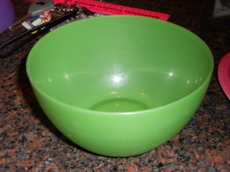
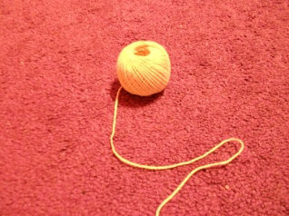
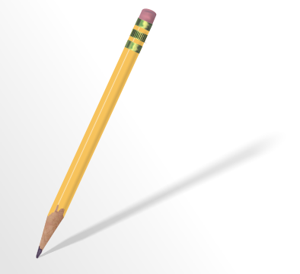
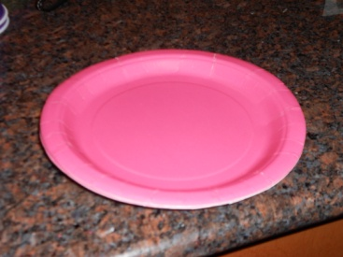
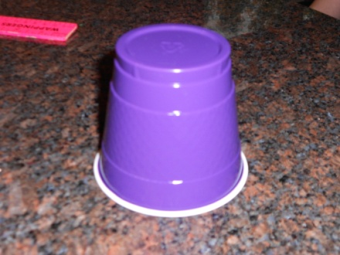
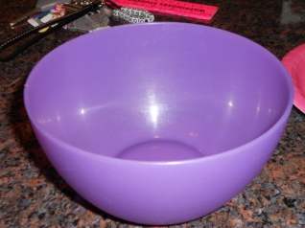
Materials:
Pen/pencil
Ruler
String
Paper
Plate
Bowl
Cup
Worksheet

Slide 5
Important Vocabulary:
Circumference: The distance around a closed curve (i.e. a circle or an ellipse).
Diameter: The distance across a circle through the center.
Radius: The distance from the center of a circle to any point along the edge of the circle.
Pi: The ratio of a circle’s circumference to its diameter.

Slide 6
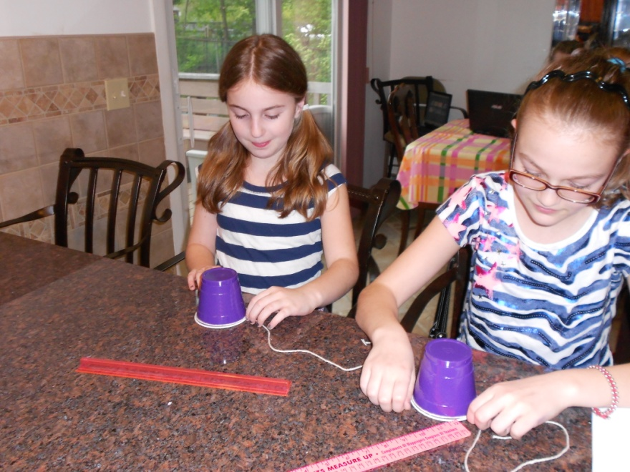
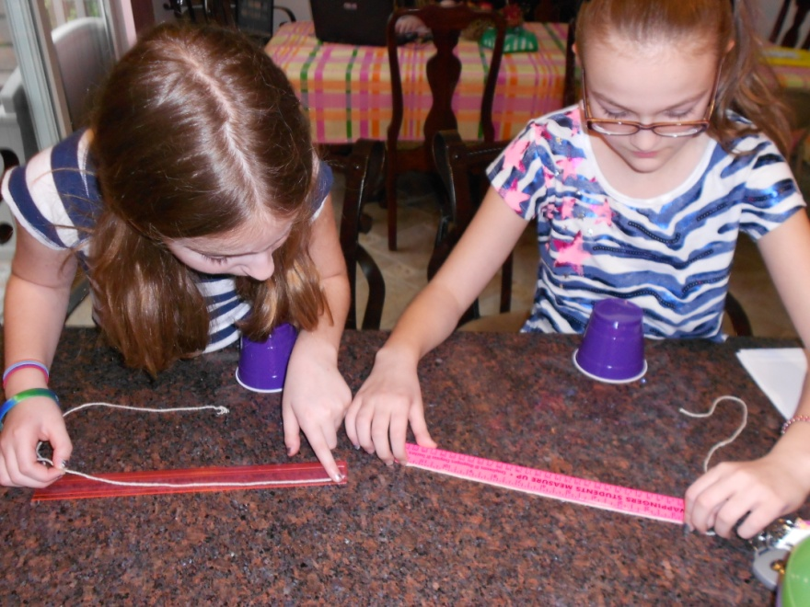
Procedure:
First, I will assess the students’ prior knowledge by reviewing the important vocabulary terms. This will ensure that the students understand what the circumference actually is.
Next, the students will be given an object and a piece of string. They will be asked to wrap the piece of string around the object. They will then create a mark on the string where the ends meet. Using a ruler, the students will measure the piece of string up to where they drew the mark. The measurement that they will get is the circumference of the circular object. This will allow the students to see the definition of circumference in action.

Slide 7
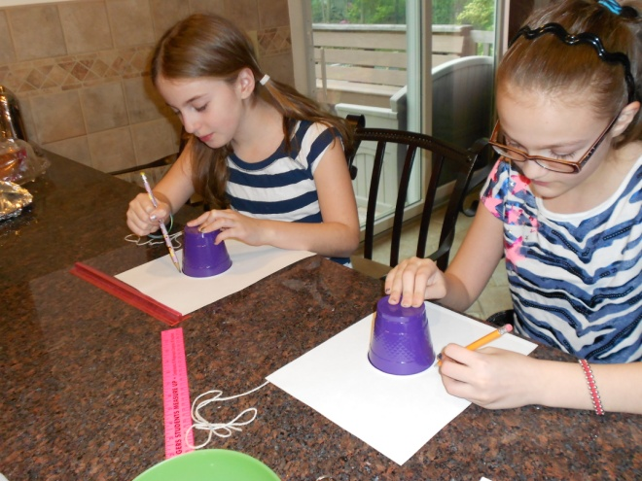
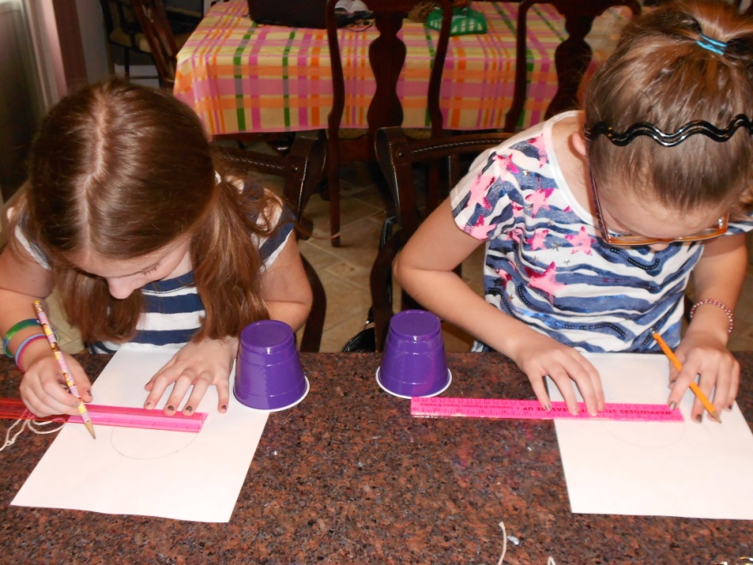
Procedure:
In order to expand on this activity, the students will
be asked to trace their object onto a plain piece of paper.
Using a ruler, the student will draw a line
through the center of the circle.
This is called the diameter.
The students can then measure the diameter with a ruler.
Now that the students know the diameter, they can calculate
the circumference of the circle in a new way! The students
can use the circumference formula: to find the circumference
of the circle. The students will record all of their information
on the worksheet provided.

Slide 8
Procedure:
Using the circumference measurement that the students got in the second step, they could also use the equation: . We know that Pi is the ratio of a circle’s circumference to its diameter.
The students will also be asked to draw a line from the center of the circle to any point along the outside of the circle. This is called the radius. The students can then use the equation: . Again, we know that Pi is the ratio of a circle’s circumference to its diameter.
Repeat this procedure for any additional objects. Using different sized objects is recommended.

Slide 9
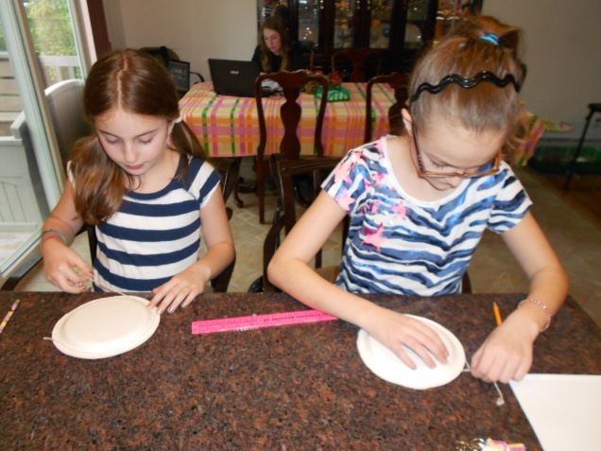
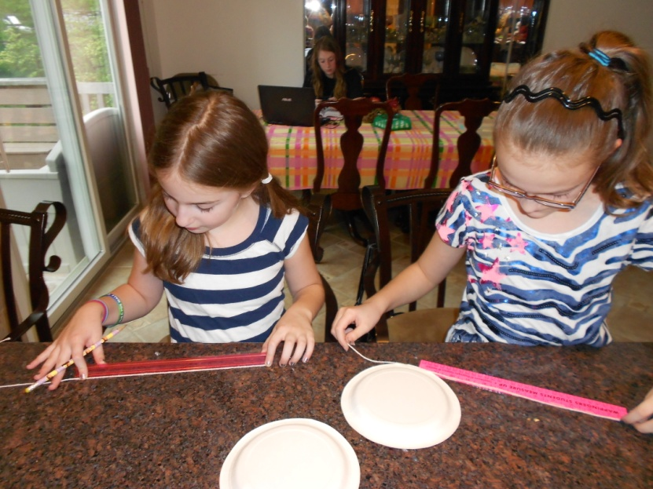
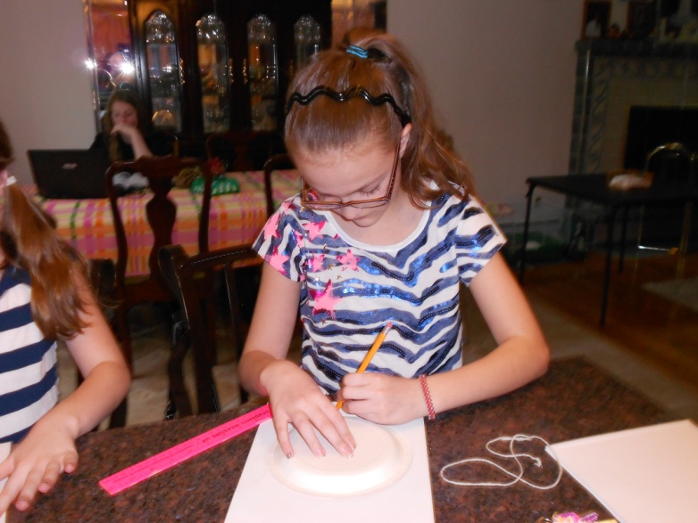
Procedure using different objects
Measure the object with a piece of string
Use a ruler to measure the piece of string to get the circumference
Trace the object onto a piece of paper

Slide 10
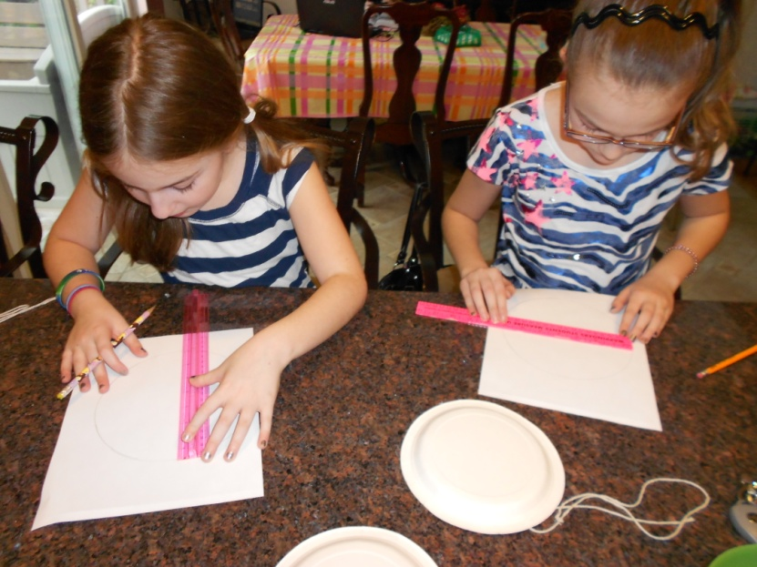
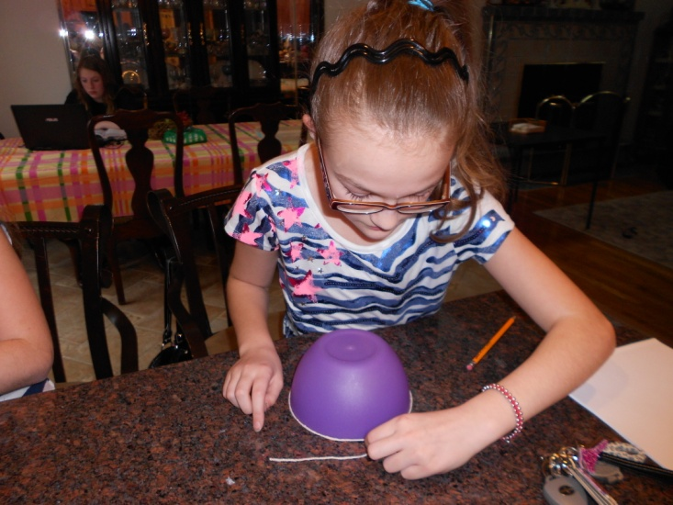
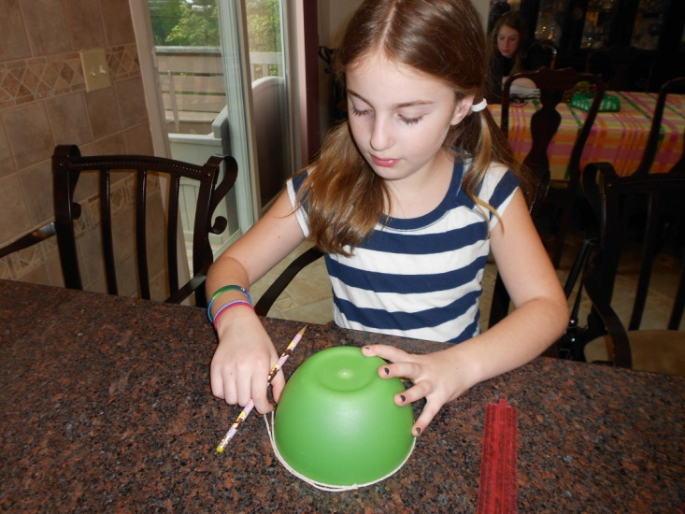
Procedure using different objects
Draw a line through the middle of the circle. This is called the diameter. Then measure the diameter with a ruler.
Continue to repeat the procedure for additional objects.

Slide 11
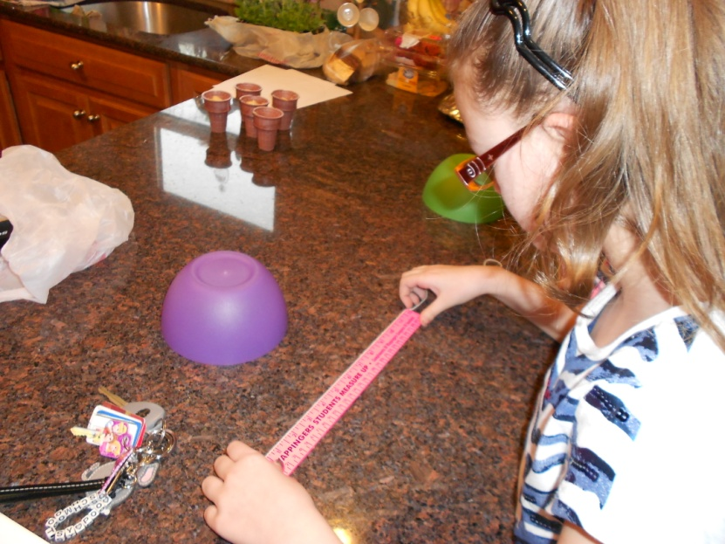
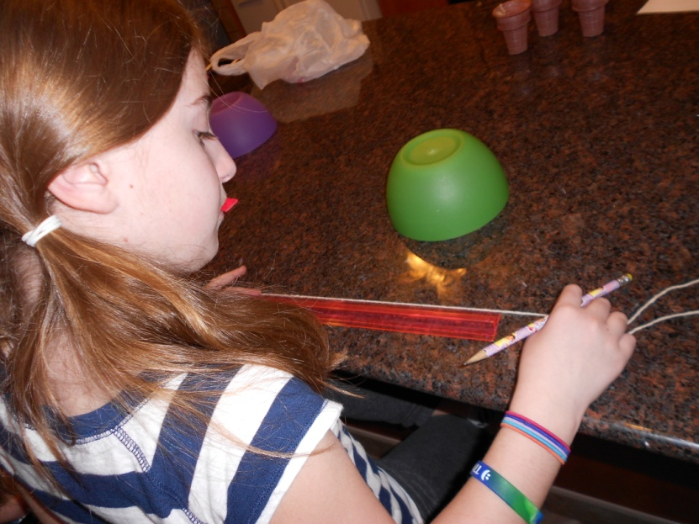
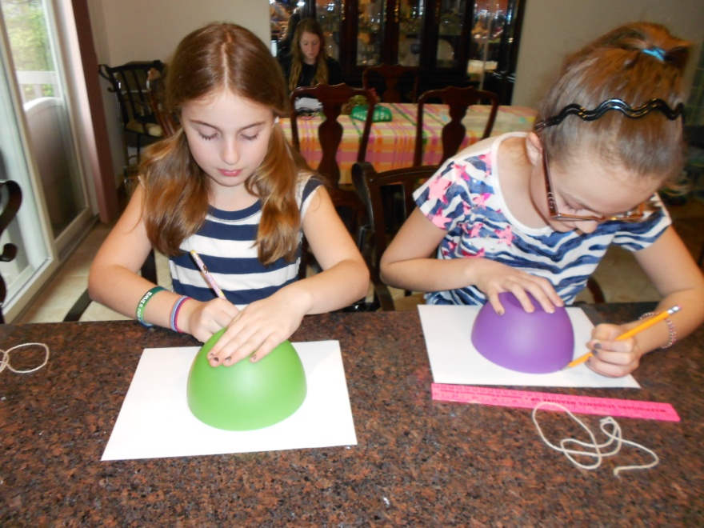
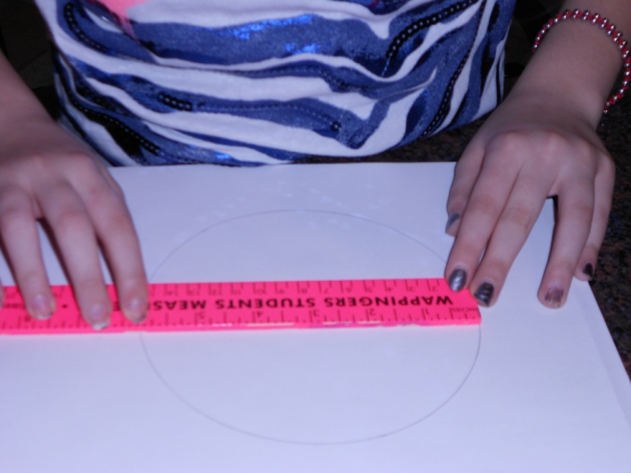

Slide 12
Worksheet:
Name________________________________ Date____________
Circumference Activity Worksheet
Object 1: __________________________________
Circumference (measured with string) | inches
Diameter | inches
Radius | inches
Using the diameter or the radius, find the circumference using the correct formula. Use the space below to show your work:

Slide 13
References
“Math projects.” ProTeacher Collection. 1998-2011. 30 April 2012.
http://www.proteacher.org/c/865_Math_Projects.html.
“National Education Standards.” Education World. 30 April 2012. http://www.educationworld.com/standards/national/index.shtml.
“Math Activities.” Middle School Geometry. 2006-2012. 30 April 2012.
http://www.education.com/activity/article/Circumference_Radius_middle/.

