Slide 1
Got Facebook?
Danielle Camporese

Slide 2
Background information
“Facebook” evolved in 2004.
Mark Zuckerberg is the creator of “Facebook.”
“TheFacebook” was the original name given to “Facebook.”
The website was originally only for college students. It was intended to be used for the students to socialize and connect to one another.

Slide 3
Background Information (Continued)
“Facebook” has majorly expanded since 2004.
Anybody and everybody can be a part of the popular website.
The Timeline profile layout is the newest addition to “Facebook.”
By the end of 2004, there were one million “Facebook” users. As of now, in February of 2012, there are about 845 million users.

Slide 4
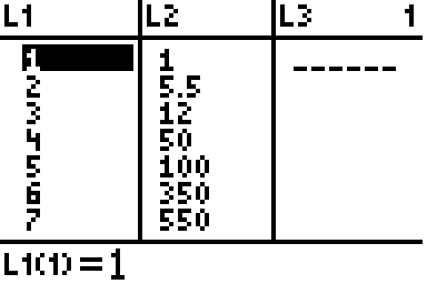
Facebook data:
Year | 2004 | 2005 | 2006 | 2007 | 2008 | 2009 | 2010 | 2011
Number of Facebook users (in millions) | 1 | 5.5 | 12 | 50 | 100 | 350 | 550 | 820
What do you think the graph will look like based on the data shown above?
Put data into calculator:

Slide 5
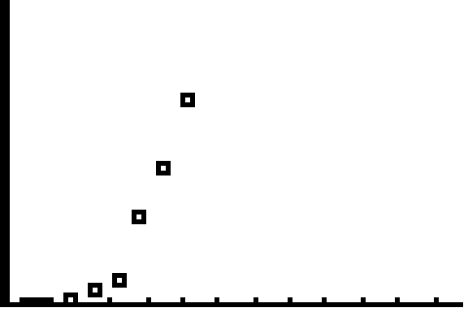
Here is your graph:
The graph shows that more people become users of Facebook as time goes on.

Slide 6
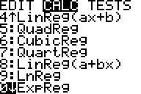
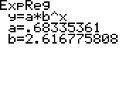
Exponential Regression
We want to determine an Exponential Regression model equation to represent this data.
First, choose the Exponential Regression Model on your calculator.
The Exponential Regression Equation is:

Slide 7
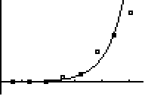
Graph the exponential regression
(Zoom #9 ZoomStat to see the graph)
Now, we want to determine:
Does this is model actually fit an Exponential Regression?
When the x-coordinates of a pair are plotted against the log of the y-coordinate and the resulting plot is a straight line, then the regression is exponential in nature.

Slide 8
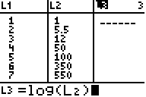
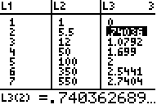
Graph the exponential regression
Let log L3 = log(L2)

Slide 9
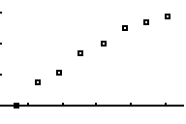
Graph the exponential regression
Use STAT PLOT to plot L1 and L3
Since the points appear to be closely related to a straight line, we can conclude that this model somewhat fits an Exponential Regression.

Slide 10
Question:
How many people will be Facebook users in the year 2030?
We know that the exponential regression equation is:
(Where x represents the year)
We can determine the number of people that will be Facebook
users in 2030 by plugging in 27 for x (because the number 27 is
the number that the year 2030 corresponds to).
We can see that this form is exponential.
Therefore, by the year 2030 there will be an exponential number of people using Facebook.

Slide 11
Conclusion
The number of people that have a Facebook account will become exponential as time goes on.
Our data has shown that more and more people become affiliated with Facebook as the years progress.
Think about this: If a new social networking website evolves, will the number of Facebook users become constant? This would be a very interesting topic to further research!

